Slide 1
Adaptive Evacuation Route Choice Modelling and Real-time Data Acquisition
OUTLINE
Introduction & Research Questions
Method for Adaptive Evacuation Route Choice Modelling
Agent’s mental map and its construction
Disaster management using agents’ trajectory
Route search-space by agent colony trajectories
Potential hazardous vertices by fitness landscape analysis
Potential trails on route search-space by ACO algorithm
Aims and Research Contribution
Evacuation Route Choice Modelling by Simulation Tools
Methodology for real-time data deployment
Technical methodology
Social methodology
Research Timeline

Slide 2
Introduction
Crowd is not simply the gathering of huge individuals. Its modelling studies aim to various purposes. One of the most important target is disaster prevention by creating evacuation plan for pedestrians. State of the art in data acquisition for crowd modelling has been performed on both of micro and macro levels but only by camera approach. This approach has significant limitations including interchangeable pedestrian detection, fixed capturing range, and occlusion at once time. They obstruct agent’s evacuation route choice behaviour modelling on agent experience and dynamic evacuation plan generation when camera surveillance hasn’t not setup or lack human guidance in time.
Inspired by biological studies, this study aims to acquire novel collectable crowd parameters from pedestrian data to enhance micro and macro levels and then propose effective evacuation plans at before and during disaster.
The study paves essentially the way for crowd modelling validation, evacuation plan studies, and foremost a valuable dataset for crowd dynamics research community.
Notes:
Micro: monitoring or detecting force, trajectory, location
Marco: monitoring density, coordinated flow emergence.
Interchangeable pedestrian at fixed camera, limit range capturing view, larger at close to camera, in narrow and long corridors, occlusion.
Can not perform pedestrian identification to simulate agent experience.
Can’t use machine learning because more feature to define, and stochastic dynamic dangers spreading.

Slide 3
Research Questions
Adaptive Evacuation Route Choice Modelling Importance
Understanding what factors influent human route choice behaviour
Understanding which route an agent will choose in the case of congestion based on his experience.
Knowing potentially hazardous congestions when agents detour in an infrastructure layout
Simulating strategic level on route choice behaviour when agent faces congestion
Creating route search-space for finding optimal evacuation route from one vertex to Exit node
Research Questions
How to model human route choice behavior from actual pedestrian data?
What factors influent agent’s route choice behaviour on micro and macro levels?
How to acquire those factors from video and mobile phone?
How to manage vast data technically and socially?
How to model and validate the impact of agent’s perception on route choice behavior?
How to enhance disaster prevention for pedestrians at before and in time it happens?
How to generate evacuation route search space from a vertex?
How to model hazard functions for vertices? (implicit and explicit potential congestions, current crowd parameters at vertices)
How to model hazard functions for edges? (visiting frequency, corridor length, current crowd density)
How to generate optimal evacuation route trails just in time? (ant will put pheromone for information of visited vertices and edges).
How do ants exploit memory context from hazard functions?
Notes:
A route that had been performed by at least one time is added into search space. A route is selected as evacuation route when it minimize potential and current hazard (congestion).
Search space comprises whole possible routes from one node to Exit gate
During evacuation plan based ACO, previous studies assume the search space including routes is pre-known. However in fact, it must be collected from ant colonies at before and in-time disaster happen.

Slide 4
Method for adaptive evacuation route choice modelling
Incorporate force-agent based model with cognitive level
Cognitive level is the place stores agent’s mental map and friend facts
An agent X has its own mental map that illustrates agent’s experience about the building’s layout. People who are familiar with building layout know whole rooms/corridors and they thus have more options for route choice.
Mental map and friend facts are updated when agent X explores building/ layout and meet friends during that duration.
Modelling human-like route choice behaviour based on agent’s accumulated knowledge and characteristic.
When agent X is at a room, force-agent model is used to check whether current route satisfies agent’s physical attributes and obstacles. Otherwise, agent’s mental map is used to retrieve another route to de-tour.
Mobile data is acquired for agent’s accumulated knowledge (position, map, trajectory, friend, physical attributes)
Camera data is acquired for density detection at known positions

Slide 5
Agent’s mental map
The mental map is a graph G(V,E) performing a network of visited rooms and corridors of a building floor on agent X’s cognitive level
Route paths are the paths from known positions to Exit gate position
An edge contains cost value based on cost estimator (travel time and visiting frequency)
A vertex contains
One optimal path (OP) and list of other global paths (GPs) to Exit gate
Paths are measured by sum of cost on that route
Linked vertices from current vertex
Vertex’s optimal path is updated and stored in agent’s cognitive level when agent finds new routes to Exit gate. Global paths are still kept in the vertex as optional choices for re-routing if necessary.

Slide 6
Agent’s mental map
Optimal path is important for:
Illustrating the most desired path at a vertex so that an agent selects that route without congestion.
Revealing the most explicitly possible congestive vertices.
Revealing potential trails for evacuation route
Global paths are important for:
Simulating agent’ experience in evacuation route choice. The more familiar with environment, the more route options the agent has.
Revealing implicitly hazardous vertices (e.g. congestion) when people de-tour. Greedy agents choose best route from their experience and have more options to de-tour, this behaviour makes the whole evacuation network inefficient [1].
Notes:
When agent X is at vertex V, force-agent model is used to check whether current route satisfies agent’s physical attributes and obstacles. Otherwise, agent’s mental map is used to choose the best route path from the global paths. This new route helps agent to de-tour.

Slide 7
Mental map and ‘human-like’ route choice modelling Optimal Path (OP) and Global Paths (GPs)
Vertex 2
OP=(V4, E)
GPs=
{GP1=(V3,E)}
cost=3
Vertex 3
OP = (E)
GPs= {}
Vertex 1
OP=(V2,V4,E)
GPs =
{GP1=(V2,V3,E)}
cost=2
cost=1
Vertex 4
OP = (E)
GPs= {}
cost=4
Vertex 5
cost=2
E-Exit
Dash lines are corridors, rooms that haven’t visited and explored by agent X

Slide 8
How to find optimal path (OP) and global paths (GP) on vertices V in agent’s mental map?
By using geometric graph theory approaches
Initial step: Initialize a graph G(V,E) = null for agent X
Initialize a list GP = null for each vertex V
Initialize an OP = null for each vertex V
Step 1: If a newly detected vertex or edge is not inside G {
1.1 Add that new vertex or edge to G
1.2 Perform following algorithms to find new GP for whole visited Vs in G
A * heuristic algorithm or
Dijkstra algorithm or
Floy-Warshall algorithm
1.3 For each vertex
if (cost function of new GP less than the cost of vertex’s current OP) {
Add OP into GP list
Assign current OP by new GP
}
}

Slide 9
Disaster prevention using agents’ trajectory
Route search space is the collection of solutions from one vertex to Exit door. Each solution has its fitness cost value
In pre-disaster : Raising awareness about evacuation route options for pedestrians
During disaster stage: Providing solution pool for real-time evacuation route filtering
Pre-disaster
During-disaster
Exit3
Hazard model
s3
Real-time Evacuation route by Route Filtering or ACO
E3
Potential hazardous vertices
s2
E1
E4
Potential trails
E2
s4
Exit2
Exit4
Vertex E1’s solution space includes solutions S2, S3,S4
Real-time Disaster context
Hazardous vertex’s current status
Potential trail’s current status
Notes:
Potential hazardous vertices are vertices include two types:
Explicitly hazardous vertices: easily occur congestion when people try to follow their desired route
Implicitly hazardous vertices: people desire to de-tour if congestion happens.
We can’t specify them by statistic by heuristic number. They are specified by fitness landscape
Hazardous model can compute for any times.
Potential hazardous trails are optimal routes, people desire to follow because they contain minimum cost on vertex and edges.
To simplify, Hazardous vertex’s status is measured by density, or fire situation level
hazardous trails is measured by density or, fire situation level

Slide 10
Generate route search-space by agent colony trajectories
Ground truth Approach
Route search space of a vertex is generated from Optimal paths of agents.
Example: Optimal paths at Vertex 1 of agents as follows
Agent X1: <V2-V4-E1> cost = 4
Agent X2: <V3-V6-E2> cost = 5
Agent X3: <V2-V4-V5-E1> cost = 6
Agent X4: <V5-E1> cost = 2
Agent X5: <V2-V4-E1> cost = 6
Step1: Eliminate solutions has sub-chromosome is another solution
Experiment results on solutions cover other solutions
Step2: Assign the minimum fitness value for same solutions
Experiment results on the variance of fitness values on the same solutions
Fitness value depends on traveling cost of agents
Greedy approach
Step1: Select all trajectories from all agents going through vertex 1.
Step2: Eliminate trajectories has sub-chromosome is another solution
Step3: Fitness value on each solution is computed by the visiting frequency on its edges
Notes:
The more agents go though a vertex to different Exit gates, the more solutions we have.
We don’t take GPs because search space will very large, the more probability it will be the same with other agents, increase computations.
How to segment a trajectory of agent, because he come into building, he wait and stand or work in a room for a long time.
Or we only calculate his traveling time on corridor and frequency.

Slide 11
Potential hazardous vertices by Fitness Landscape Analysis
Hazardous vertices analysis are used to reveal risk status at:
explicitly congestive vertices by using agents’ optimal paths
implicitly congestive vertices when people intend to de-tour by using agents’ global paths.
Example on constructing Fitness Landscape of Optimal Paths of a floor layout from collected search spaces
Search space of Vertex 1: S1, S2,S3,S4
Search space of Vertex 2: S1, S2,S3,S4
Search space of Vertex 3: S1, S2,S3,S4
However, some spaces are inside other spaces→ Remove sub-spaces to construct landscape.

Slide 12
Potential hazardous vertices by Fitness Landscape Analysis
Example on constructing Fitness Landscape of Optimal Paths of a floor layout from collected search spaces
Vertices jointed the most between solution spaces are hazardous vertices such as V3
V1
V1_{s2}
V1_{s1}
V1_{s3}
V2
E1
V3
V4
V5
V6_{s1}
V6_{s3}
E2
V6_{s2}
V6

Slide 13

Potential evacuation route trails by ACO on route search space
Potential trails contains optimal edges and vertices.
Cost of each vertex is measured by its average density.
Cost of each edge is measured by its visiting frequency
From route search space of vertex 1, its solutions {s2,s3,s4,s5,s6,s7}.
We have two approaches to identify potential route trails:
Geometric graph theory
ACO
V1, cost=1
s4
s2
s5
V4
cost=4
This ant will deposit pheromones equivalent to the inverse of cost function from visited nodes and edges.
s3
s6
s7
V2
cost=2
V3
cost=3
V5
cost=2
E1
E4
E3
E2
Notes:
We cannot use cost of GP or OP because they are depends on traveling frequency cost function of each people on edge.
We still need search space such as between V3, it lead to 2 exits gate
Here we focus on information at each vertex.
We have two approaches here, using geometric graph theory or ACO. We then compare accuracy.
To balancing exploration & exploitation, we need to inverse of cost trail hardzardous. Ant speed, hazardous changing
The foraging ants release pheromone on favourable paths, the trail will be increased since ant members then follow more on the trail regardless evaporation process. This is the way ant colonies walk more towards favourable path iteratively.
The more cost, the less attractive level on that route

Slide 14
Research Aims
Explore novel collectable data from mobile and camera for crowd modelling metrics.
1.1. Agent’s cognitive level: mental map and friend facts
1.2. Agent’s physical attributes: average speed, adjustor, desired avoiding distance
1.3. Crowd’s current parameters on micro and macro levels
1.3.1 Agent’s current location
1.3.2 Density, pressure, turbulence at a fixed position by camera
Model and validate route choice behavior for force agent-based model based on cognitive level from collected data by crowd dynamics.
Explore effective optimization techniques to create evacuation plan for pre and during disasters happen.
3.1. Route search space
3.2. Hazardous function for vertices and potential trails

Slide 15
Research Contribution
Evacuation plan
Exploring factors that affect agent’s route decision making behavior and their usefulness in evacuation plan.
Initializing route searching space for evacuation plan
Knowing potential hazards
Allowing to test with different infrastructure layouts and different evacuation dynamics from agents those data correspond to real persons
Crowd modelling validation
Providing a new validatable model to simulate and identify desired route for agents. It’s testable with actual pedestrian data from both of camera and mobile. This is a novel approach to broaden crowd simulation models when innovatively using mobile phone data.
Crowd Research community
Contributing a novel dataset for crowd dynamics study

Slide 16
Proposed Evacuation Model by Simulation Tools
Main aims:
Simulate agent’s heterogeneous physical attributes
Simulate agent’s perception on adaptive mental map and friend graph
Incorporate a desire force by the new route direction fetched from mental map to social-force model to help agent de-tour when facing congestion.
Agents inside the cut-off distance can share their mental maps to derive a more comprehensive map of the building.
Allow agents to transit from normal behaviour to panic condition when out of route choice options.
Simulation Methodology
Simulation environment:
E-Sim, Path Finder, Repast Simphony, MATSim simulation tools
Cognitive level to store mental map
Method to simulate agent’s knowledge
Generate randomly routes for an agent X to explore a predefined layout
Update agent X’s cognitive level with mental map and friend graph
Simulate agent X’s de-tour ability

Slide 17
Evacuation Route Choice Modelling by Simulation Tools
Agent’s physical attributes and current status
Agent perceives environment on current route in an interval t
Agent’s accumulated knowledge
Identify average behaviour effects by social-force model on that route
Identify potential position
Update new agent’s status
Satisfy agent’s attributes
Infer new route to Exit gate from current location
yes
no
count step
Identify new velocity from current velocity and adjuster
yes
Same current route
no
* Same route for n steps causes bottle-neck and attribute’s changes
Notes:
Each behaviour effect (follow, avoid collision, drastic walls, other people, social friends, desired route) has its own direction. We plus by force and combine by direction.
Finally, we achieve new force and direction, we then calculate new position on that direction.

Slide 18






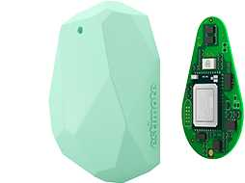

Methodology for real-time data acquisition Technical deployment
update
Position identification server
Cache
Scheduling jobs
Job scripts
Position identification server
Agent’s Mental Map
retrieve location
Route Search Space
Hazardous Model
Indoor Positioning System
Data Acquisition System
iBeacon devices at known locations
Devices collect Bluetooth addresses of iBeacons and other mobile devices
Triangular positioning
Detected position is stored in Cache
Return to mobile upon requests for map displaying
Jobs are run periodically
Hazardous vertices and potential trails are returned upon requests
Notes:
-Reason use iBeacon because: cheap, indoor, we can check vulnerable status in real-time fire, it’s doesn’t work instead of Wi-Fi
-Wi-Fi takes Wi-Fi sensor, if we collect other Bluetooth for friends, battery drains, less built-in mobile sensors is better for battery lifetime.

Slide 19
Methodology for real-time data acquisition Technical deployment
update
Position identification server
Cache
Scheduling jobs
Job scripts
Position identification server
retrieve location
Group information
Pedestrian information
Indoor Positioning System
Data Acquisition System
iBeacon devices at known locations
Devices collect Bluetooth addresses of iBeacons and other mobile devices
Triangular positioning
Detected position is stored in Cache
Return to mobile upon requests for map displaying
Jobs are run periodically
Hazardous vertices and potential trails are returned upon requests
Notes:
-Reason use iBeacon because: cheap, indoor, we can check vulnerable status in real-time fire, it’s doesn’t work instead of Wi-Fi
-Wi-Fi takes Wi-Fi sensor, if we collect other Bluetooth for friends, battery drains, less built-in mobile sensors is better for battery lifetime.

Slide 20
Methodology for real-time data deployment Social deployment
Trial system in Monash Caulfield Lab’s floor 6
Assume Monash IT NICTA is familiar with building H’s floor 6. The floor is narrow, we can’t validate on route choice model or avoiding obstacles. We only identify indoor positions and generate agent’s mental maps, evacuation route search space, hazardous vertices and potential trails.
In a conference forum in Melbourne
A survey is proposed to ask whether attendees are familiar with that layout.
If agent X is familiar, we assume it has full map architecture and we only find OP and GPs for the agent.
Data will be collected within 2 days.
Generate agent’s mental map, validate model at route choice level and behavioural level (avoid obstacle).
Generate route search space, and perform hazardous modelling.
Perform virtual agent simulation and crowd dynamics.
Test in another conference forum to generate real-time evacuation route filtering as fire disaster is happening.
Fired rooms are considered when iBeacons turn off or camera notifies.
Notes:
The more data, the more options for route choice behaviour happens. That’s why we need 2 days

Slide 21
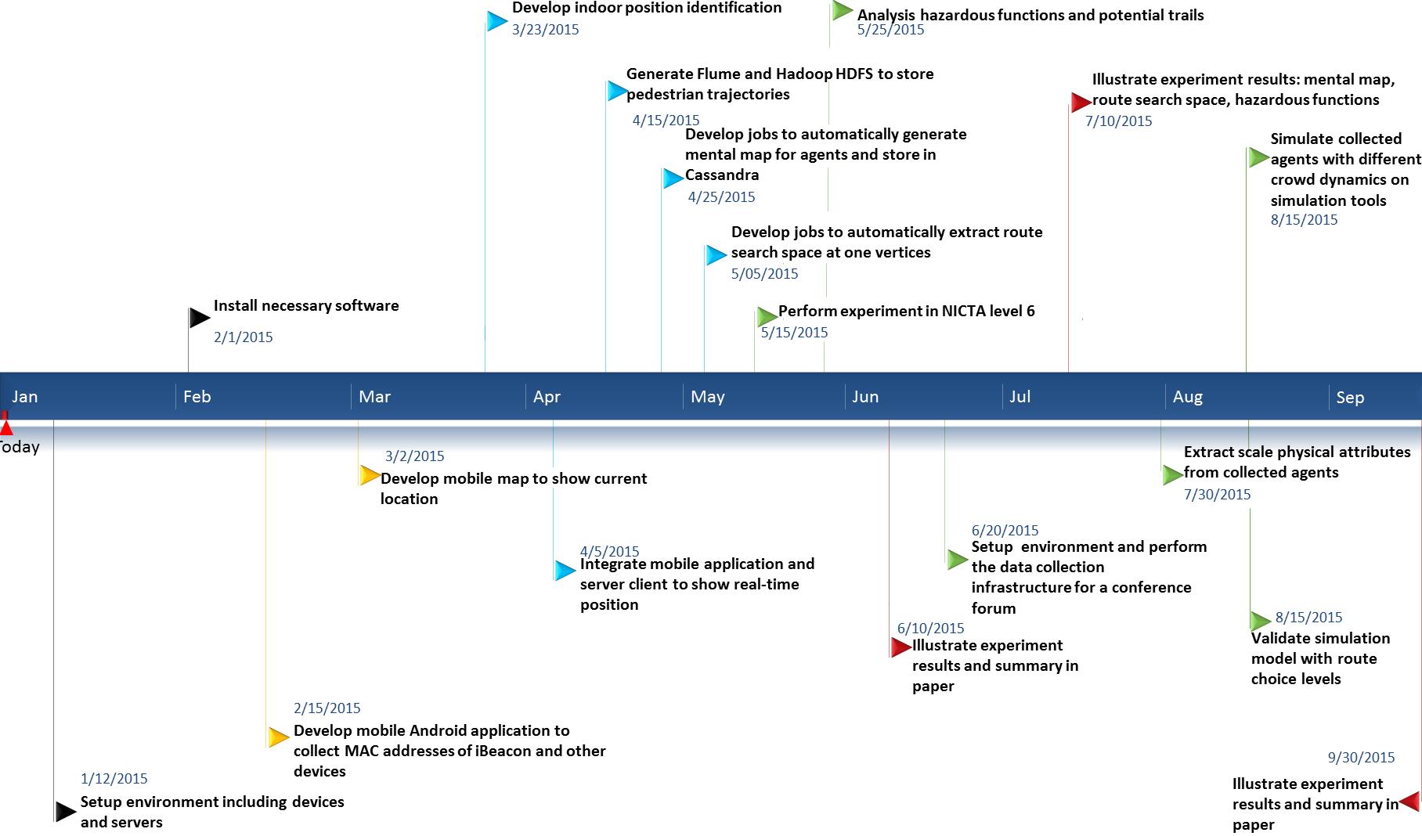
Research Timeline
2015 Research Timeline
Notes:
2015 – focus on data acquisition infrastructure in above three case studies. (Next slide for detail)
2016 – focus more on analysing hazardous function analysis and other metaheuristic algorithms, or even swarm optimization for contagion problem, or AntNet.

Slide 22






wall
$$\vec{γ}$$
$$γ_{1}$$
$$γ_{2}$$
target
$$\vec{e_{p}^{d}}(t)$$
$${\vec{f}}_{pq}$$
p
$${\vec{f}}_{pγ}$$
q

Slide 23
Group-based calibration approach
Pedestrian type-based calibration approach
Verified by
Verified by
Different scenarios of the same group
Other groups in the same scenario

Slide 24
River form 1

Slide 25
Simulation
social group force model
Group member’s parameters
measure
validate

Slide 26
Evacuation scenarios
Escape rate
Human group cohesion model
Group cohesion observation
Group cohesion degree
Group formation
Group speed

Slide 27
Group member
Pedestrian type
Position
Speed
Group information
Group size
Group centre of mass
Group leader
Position
Speed
Turning, Diverging, Merging
scenarios

Slide 28
Parameter Initialization
Control parameter
Flow rate measurement
Group force model simulation
measure
Parameter analysis
validate

Slide 29

Group member’s initial parameters
Desired acceleration $V^{Id}$
Acceleration time $τ$
Interaction Strength $A$
Interaction Range B
Social group force simulation
Group cohesion measurement
Cohesion degree
Average speed
Average direction
Group member
Velocity
Moving direction

Slide 30
Today

Slide 31
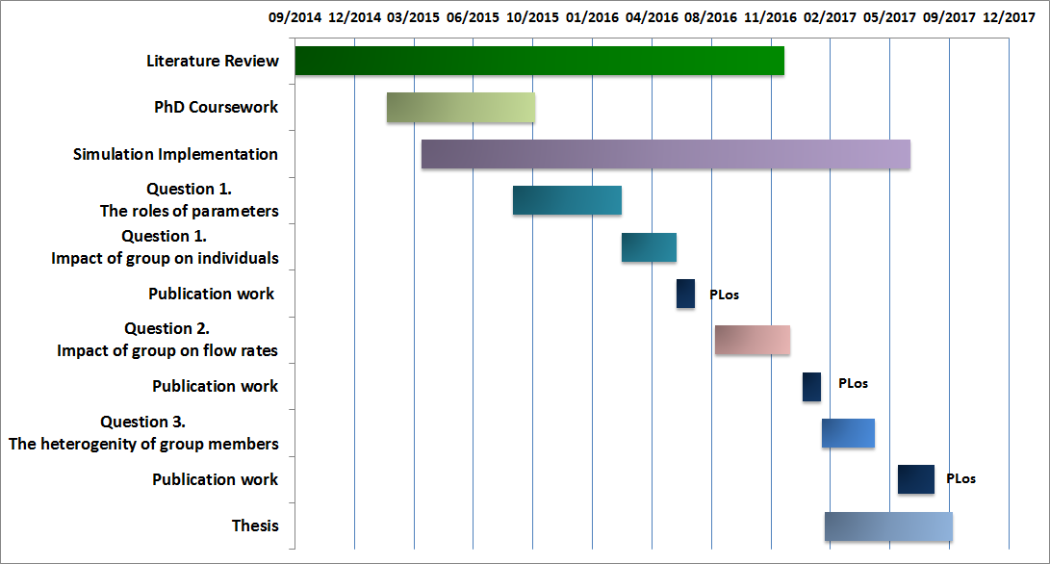
Today

Slide 32
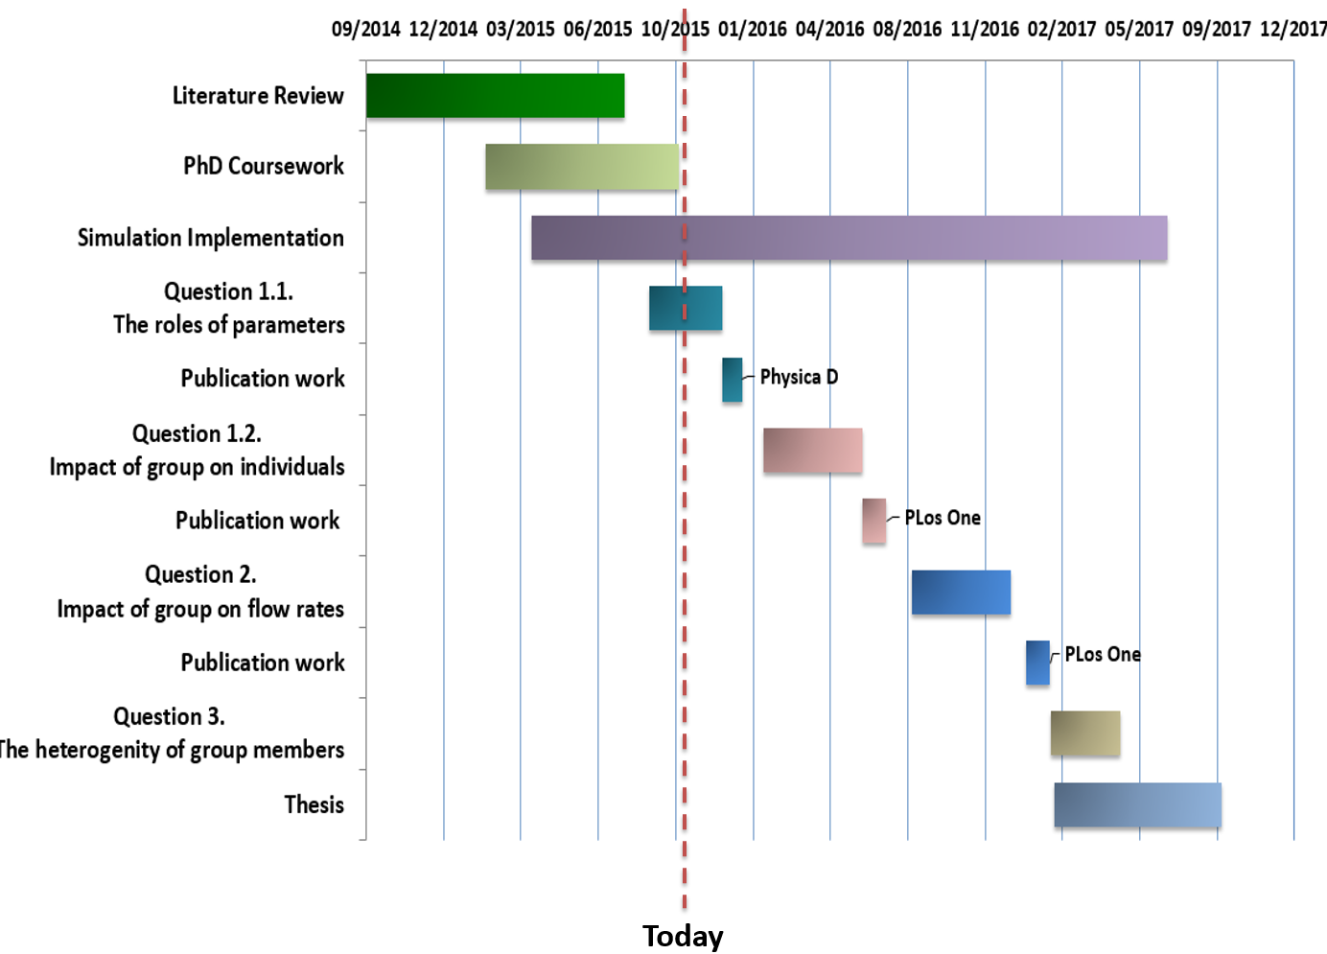

Slide 34







wall
target
$$γ_{2}$$
$$\vec{γ}$$
$${\vec{H}}_{p}$$
$α_{p}$
$$pedestrian p$$
$$c_{i}$$
$${\vec{f}}_{pγ}$$

Slide 35

10 m
8 m
7 m
39 m

Slide 36

wall
$$\vec{γ}$$
$$γ_{1}$$
$$γ_{2}$$
target
$$\vec{e_{p}^{d}}(t)$$
$${\vec{f}}_{pq}$$
p
$${\vec{f}}_{group}$$
Group center of mass
$${\vec{f}}_{pγ}$$
q

Slide 37
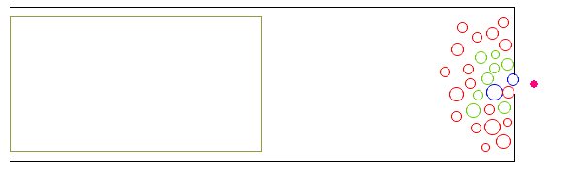
13 m
8 m
7 m
1 m
26 m

